Slide 1

A
Project Report
on
Foundation Management System
Developed by
MODH DISHANT(IT-070) - Department of IT, DD University
JAY PANCHAL(IT-079) - Department of IT, DD University
Guided By
Internal Guide:
Prof. Archana N. Vyas
Prof. Vidhi Chaudhari
Department of Information Technology
Faculty of Technology
DD University
Department of Information Technology Faculty of Technology, Dharmsinh Desai University College Road, Nadiad-387001
October-2019
DHARMSINH DESAI UNIVERSITY

Slide 2
ACKNOWLEDGEMENT
We would like to give our sincere acknowledgement to everybody responsible for the successful completion of our project “UNIVERSITY STUDENT MANAGEMENT SYSTEM”
The success and final outcome of this project required a lot of guidance and assistance from many people and we are extremely privileged to have got this all along the completion of this project.
We owe our deep gratitude to our project guide Prof. Roshni M. Raval, who took been interest on our project work and guided us all along till the completion of our project work by providing all the necessary help for developing a good Database System.
We would also like to thank all our lecturers.
Finally we convoy our acknowledgement to all our friends and family members who directly or indirectly associated with us in the successful completion of the project.We thank one and all.

Slide 3
1.SYSTEM OVERVIEW
1.1 CURRENT SYSTEM
University Student Management System is engineered to effectively administer every aspect of a University\College Student problem which they face while entering into new University\College at any unknown place.
Any Student who enters into new University/College they face some basic and huge problem like Finding PG\Hostel, Senior Contact for some notes, College Book’s for reading or if they want to buy them, and also for eating it will show restaurants.
It will also show the different type of Activity organised by his/her particular University/College and it also show the different Event’s occurring in his/her University/College.

Slide 4
1.2 OBJECTIVES OF THE PROPOSED SYSTEM
Students can easily find Broker’s for their Living, can easily get information for nearby restaurant for their Eating.
Getting contact of their Senior form which, they can get help.
They can contact their Activity Head easily.
1.3 ADVANTAGES OF STUDENT MANAGEMENT SYSTEM
Through this system we try to achieve the below objectives
To help students by providing study material from their seniors
Students can know all the available restaurants and caters for their breakfast, lunch and dinner.
Students can explore their interest by doing activities
Students can find rent house or hostel easily.
Students can also get their second-hand study material help easily.
Also, they find Stationery and Xerox stuff easily.
By using this system students can easily figure out which stationary or restaurants or Hostels are good for them, facility wise as well as price wise.

Slide 5
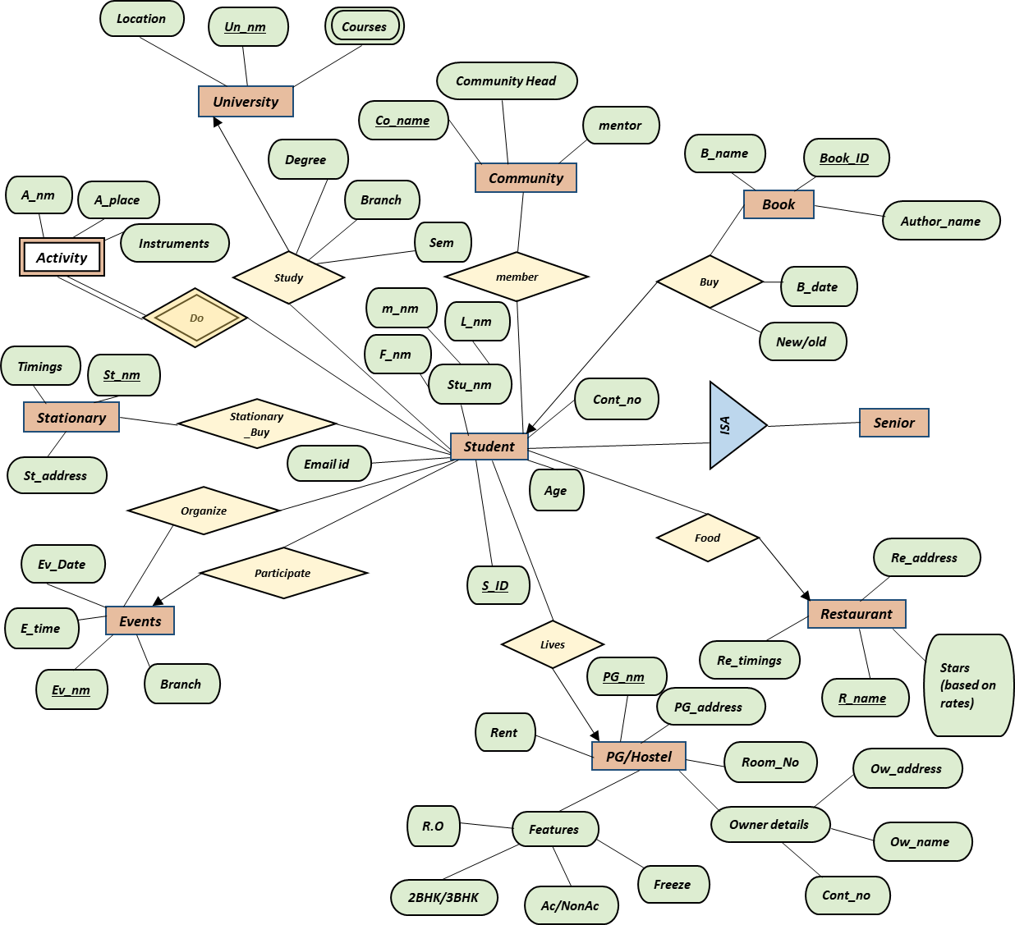
*
Manage
*
2.ER DIAGRAM
Manage
*
*
*
Manage
1
*
*
*
1
*
*
*
*
*
Manage
Username
Manage
*
*
*
*
*
Admin
*
*
*
Help
*
Manage
Password
*
*
*
*
*
1
*
Manage
1
Manage
*
*
*
*
1
Manage
*

Slide 6

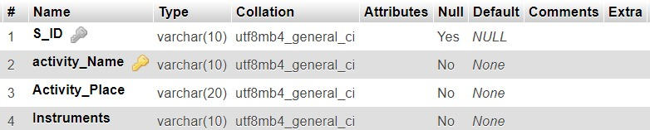

3. REALATIONAL
DATA
BASE
1. University
2. Activity
3. Courses

Slide 7
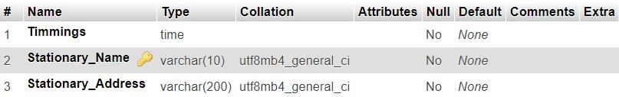
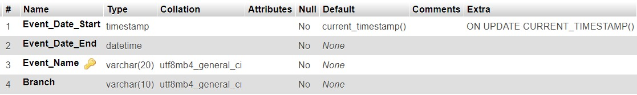
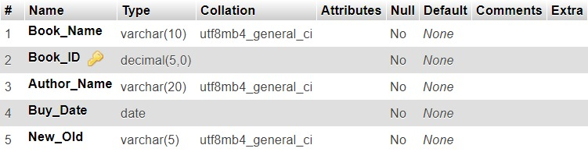
4. STATIONARY
5. EVENTS
6. BOOK

Slide 8
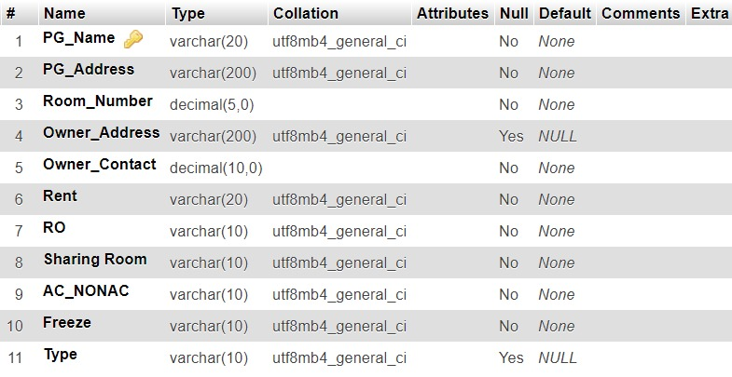
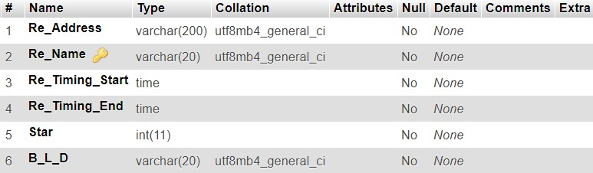
7. PG/HOSTEL
8. Restaurant

Slide 9
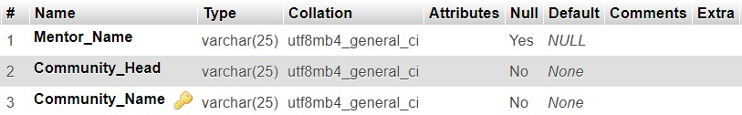
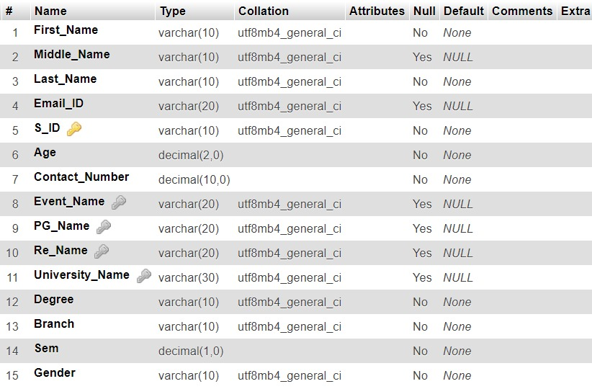
9. COMMUNITY
10. STUDENT

Slide 10
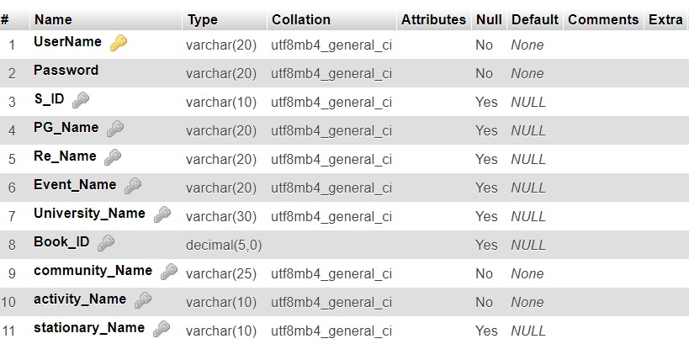

11. ADMIN
12. STATIONARY_BUY

Slide 11


13. MEMBER
14. ORGANIZE

Slide 12
5.DATABASE IMPLEMENTATION
5.1 CREATE SCHEMA
5.1.1 STUDENT
CREATE TABLE STUDENT (First_Name VARCHAR(10) NOT NULL, Middle_Name VARCHAR(10) DEFAULT NULL, Last_Name VARCHAR(10) NOT NULL, Email_ID VARCHAR(20) DEFAULT NULL, S_ID VARCHAR(10) PRIMARY KEY, Age DECIMAL(2) NOT NULL, Contact_Number DECIMAL(10) NOT NULL, Event_Name VARCHAR(10), PG_Name VARCHAR(20), Re_Name VARCHAR(10), University_Name VARCHAR(30), Degree VARCHAR(10) NOT NULL, Branch VARCHAR(10) NOT NULL, Sem DECIMAL(1) NOT NULL);
ALTER TABLE `student` ADD CONSTRAINT `student1` FOREIGN KEY (`Event_Name`) REFERENCES `events` (`Event_Name`);
ALTER T)ABLE `student` ADD CONSTRAINT `student2` FOREIGN KEY (`PG_Name`) REFERENCES `pg_hostel` (`PG_Name`);
ALTER TABLE `student` ADD CONSTRAINT `student3` FOREIGN KEY (`Re_Name`) REFERENCES `resturant` (`Re_Name`);
ALTER TABLE `student` ADD CONSTRAINT `student4` FOREIGN KEY (`University_Name`) REFERENCES `university` (`University_Name`);
5.1.2 COMMUNITY
CREATE TABLE COMMUNITY (Mentor_Name VARCHAR(25) DEFAULT NULL, Community_Head VARCHAR(25) NOT NULL, Community_Name VARCHAR(25) PRIMARY KEY);

Slide 13
5.1.3 STATIONARY
CREATE TABLE STATIONARY (Timmings TIME NOT NULL, Stationary_Name VARCHAR(10) PRIMARY KEY, Stationary_Address VARCHAR(200) NOT NULL);
5.1.4 EVENT
CREATE TABLE EVENTS(Event_Date_Start TIMESTAMP NOT NULL, Event_Date_End DATETIME NOT NULL, Event_Name VARCHAR(20) PRIMARY KEY, Branch VARCHAR(10) NOT NULL);
5.1.5 BOOK
CREATE TABLE BOOK (Book_Name VARCHAR(10) NOT NULL, Book_ID DECIMAL(5) PRIMARY KEY, Author_Name VARCHAR(20) NOT NULL, Buy_Date DATE NOT NULL, New_Old VARCHAR(5) NOT NULL);

Slide 14
5.1.6 PG_HOSTEL
CREATE TABLE PG_HOSTEL (PG_Name VARCHAR(20) PRIMARY KEY, PG_Address varchar(200) NOT NULL, Room_Number DECIMAL(5) NOT NULL, Owner_Address VARCHAR(200) DEFAULT NULL, Owner_Contact DECIMAL(10) NOT NULL, Rent VARCHAR(20) NOT NULL, RO VARCHAR(10) NOT NULL, TWO_BHK_3BHK VARCHAR(10) NOT NULL, AC_NONAC VARCHAR(10) NOT NULL, Freeze VARCHAR(10) NOT NULL);
5.1.7 RESTURANT
CREATE TABLE Resturant (Re_Address VARCHAR(200) NOT NULL, Re_Name VARCHAR(20) PRIMARY KEY, Re_Timing_Start TIME NOT NULL, Re_Timing_End TIME NOT NULL, Star INT NOT NULL, B_L_D VARCHAR(20) NOT NULL);
5.1.8 ADMIN
CREATE TABLE ADMIN (UserName VARCHAR(20) PRIMARY KEY, Password VARCHAR(20) NOT NULL, S_ID VARCHAR(10), PG_Name VARCHAR(20), Re_Name VARCHAR(20), Event_Name VARCHAR(20), University_Name VARCHAR(10), Book_ID DECIMAL(5), community_Head VARCHAR(10) NOT NULL, Acitvity_Name VARCHAR(10) NOT NULL, stationary_Name VARCHAR(10))
ALTER TABLE `admin` ADD CONSTRAINT `amin1213` FOREIGN KEY (`stationary_Name`) REFERENCES `stationary` (`stationary_Name`)

Slide 15
5.1.9 ORGANIZE
CREATE TABLE Oraganize(S_ID VARCHAR(10), Event_Name VARCHAR(10) PRIMARY KEY)
5.1.10 STATIONARY_BUY
CREATE TABLE stationary_Buy (S_ID VARCHAR(10), stationary_Name VARCHAR(10) PRIMARY KEY)
ALTER TABLE `stationary_buy` ADD CONSTRAINT `sb` FOREIGN KEY (`S_ID`) REFERENCES `student` (`S_ID`)
5.1.11 MEMBER
CREATE TABLE member (S_ID VARCHAR(10),community_Name VARCHAR(25));
ALTER TABLE `member` ADD CONSTRAINT `m2` FOREIGN KEY (`S_ID`) REFERENCES `student` (`S_ID`);
ALTER TABLE `member` ADD CONSTRAINT `m3` FOREIGN KEY (`community_Name`) REFERENCES `community` (`community_Name`);

Slide 16
5.1.12 UNIVERSITY
CREATE TABLE University (University_Name VARCHAR(30) PRIMARY KEY, Location VARCHAR(200) NOT NULL)
5.1.13 COURSES
CREATE TABLE Courses (University_Name VARCHAR(30), Courses_Name VARCHAR(10) NOT NULL)
ALTER TABLE `courses` ADD CONSTRAINT `COURSES` FOREIGN KEY (`University_Name`) REFERENCES `university` (`University_Name`)
5.1.14 ACTIVITY
CREATE TABLE Activity (S_ID VARCHAR(10), Activity_Name VARCHAR(10) PRIMARY KEY, Activity_Place VARCHAR(20) NOT NULL, Instruments VARCHAR(10) NOT NULL)

Slide 17
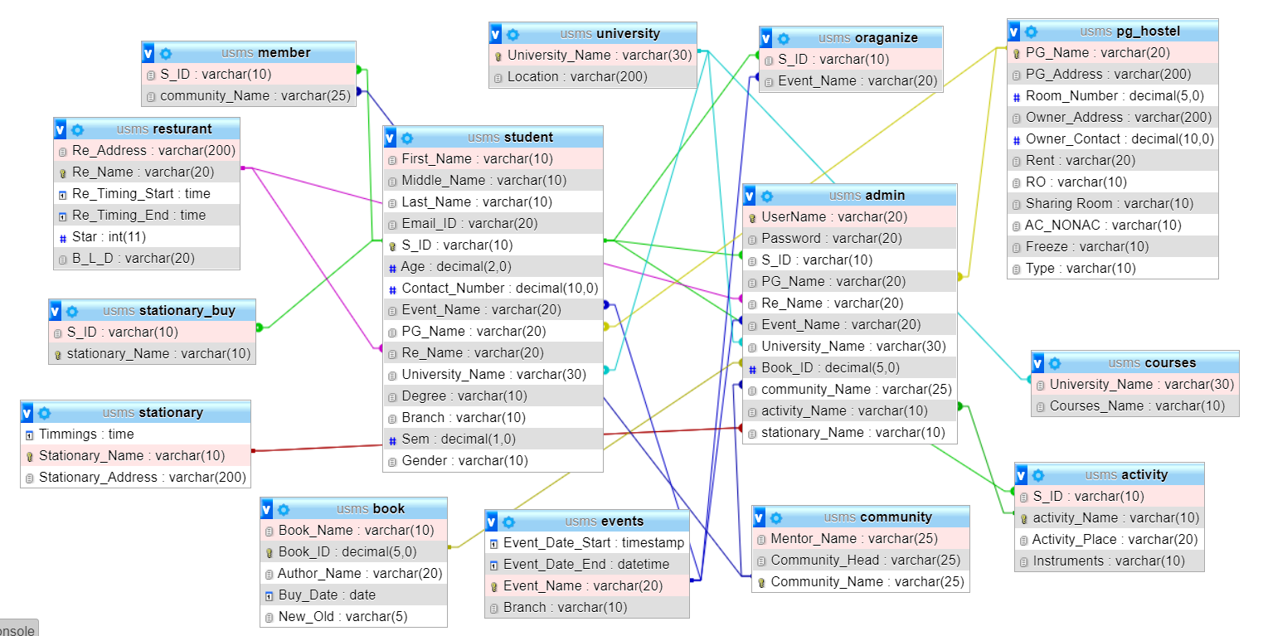

Slide 18
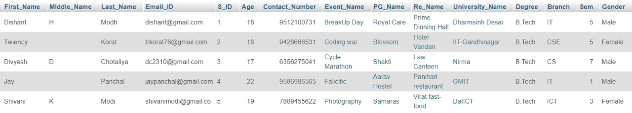
5.DATABASE IMPLEMENTATION
5.2 INSERT DATA VALUE
5.2.1 STUDENT
INSERT INTO `student`(`First_Name`, `Middle_Name`, `Last_Name`, `Email_ID`, `S_ID`, `Age`, `Contact_Number`, `Event_Name`, `PG_Name`, `Re_Name`, `University_Name`, `Degree`, `Branch`, `Sem`) VALUES ('Dishant','H','Modh','dishant@gmail.com','1', 18, 9512100731,'BreakUp Day','Royal Care','Prime Dinning Hall','Dharmsinh Desai','B.Tech','IT',5,’Male’ );
INSERT INTO `student`VALUES ('Twiency','','Korat','trkorat76@gmail.com','2', 18, 9428666531,'Coding war','Blossom','Hotel Vandan','IIT-Gandhinagar','B.Tech','CSE',5,'Female');
INSERT INTO `student`VALUES ('Divyesh','D','Chotaliya','dc2310@gmail.com','3', 17, 6356275041,'Cycle Marathon','Shakti','Law Canteen','Nirma','B.Tech','CS',7,'Male' );
INSERT INTO `student` VALUES ('Jay','','Panchal','jaypanchal@gmail.com','4', 22, 9586986565,'Falicific','Aarav Hostel','Panihari restaurant','GMIT','B.Tech','IT',1 ,'Male');
INSERT INTO `student`VALUES ('Shivani','K','Modi','shivanimodi@gmail.com','5', 19, 7889455622,'Photography','Samaras','Virat fast-food','DaIICT','B.Tech','ICT',3,'Female' );

Slide 19
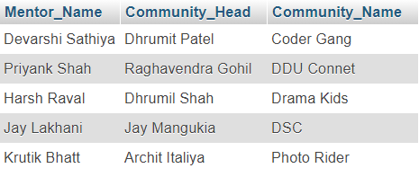
5.2.2 COMMUNITY
INSERT INTO `community`(`Mentor_Name`, `Community_Head`, `Community_Name`) VALUES ('Harsh Raval', 'Dhrumil Shah', 'Drama Kids');
INSERT INTO `community`(`Mentor_Name`, `Community_Head`, `Community_Name`) VALUES ('Devarshi Sathiya', 'Dhrumit Patel', 'Coder Gang');
INSERT INTO `community`(`Mentor_Name`, `Community_Head`, `Community_Name`) VALUES ('Priyank Shah', 'Raghavendra Gohil', 'DDU Connet');
INSERT INTO `community`(`Mentor_Name`, `Community_Head`, `Community_Name`) VALUES ('Krutik Bhatt', 'Archit Italiya', 'Photo Rider');
INSERT INTO `community`(`Mentor_Name`, `Community_Head`, `Community_Name`) VALUES ('Jay Lakhani', 'Jay Mangukia', 'DSC');

Slide 20
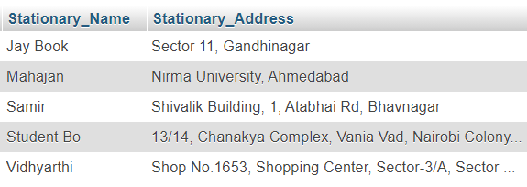
5.2.3 STATIONARY
INSERT INTO `stationary`(`Timmings`, `Stationary_Name`, `Stationary_Address`) VALUES ('09:00:00','Samir','Shivalik Building, 1, Atabhai Rd, Bhavnagar');
INSERT INTO `stationary`(`Timmings`, `Stationary_Name`, `Stationary_Address`) VALUES ('11:00:00','Mahajan','Nirma University, Ahmedabad');
INSERT INTO `stationary`(`Timmings`, `Stationary_Name`, `Stationary_Address`) VALUES ('09:00:00','Vidhyarthi','Shop No.1653, Shopping Center, Sector-3/A, Sector 3, Gandhinagar');
INSERT INTO `stationary`(`Timmings`, `Stationary_Name`, `Stationary_Address`) VALUES ('10:00:00','Jay Book ',' Sector 11, Gandhinagar');
INSERT INTO `stationary`(`Timmings`, `Stationary_Name`, `Stationary_Address`) VALUES ('09:00:00','Student Book','13/14, Chanakya Complex, Vania Vad, Nairobi Colony, Nadiad');

Slide 21
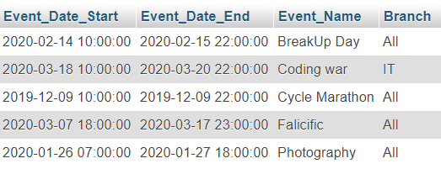
5.2.4 EVENTS
INSERT INTO `events`(`Event_Date_Start`, `Event_Date_End`, `Event_Name`, `Branch`) VALUES ('2019-12-09 10:00:00','2019-12-09 22:00:00','Cycle Marathon','All');
INSERT INTO `events`(`Event_Date_Start`, `Event_Date_End`, `Event_Name`, `Branch`) VALUES ('2020-01-26 07:00:00','2020-01-27 18:00:00','Photography','All');
INSERT INTO `events`(`Event_Date_Start`, `Event_Date_End`, `Event_Name`, `Branch`) VALUES ('2020-02-14 10:00:00','2020-02-15 22:00:00','BreakUp Day','All');
INSERT INTO `events`(`Event_Date_Start`, `Event_Date_End`, `Event_Name`, `Branch`) VALUES ('2020-03-07 18:00:00','2020-03-17 23:00:00','Falicific','All');
INSERT INTO `events`(`Event_Date_Start`, `Event_Date_End`, `Event_Name`, `Branch`) VALUES ('2020-03-18 10:00:00','2020-03-20 22:00:00','Coding war','IT');

Slide 22
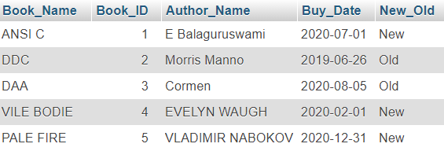
5.2.5 BOOK
INSERT INTO `book`(`Book_Name`, `Book_ID`, `Author_Name`, `Buy_Date`, `New_Old`) VALUES ('ANSI C', 1 , 'E Balaguruswami', '2020-07-01', 'New');
INSERT INTO `book`(`Book_Name`, `Book_ID`, `Author_Name`, `Buy_Date`, `New_Old`) VALUES ('DDC', 2 , 'Morris Manno', '2019-06-26', 'Old');
INSERT INTO `book`(`Book_Name`, `Book_ID`, `Author_Name`, `Buy_Date`, `New_Old`) VALUES ('DAA', 3 , 'Cormen', '2020-08-05','Old');
INSERT INTO `book`(`Book_Name`, `Book_ID`, `Author_Name`, `Buy_Date`, `New_Old`) VALUES ('VILE BODIES', 4 , 'EVELYN WAUGH', '2020-02-01', 'New');
INSERT INTO `book`(`Book_Name`, `Book_ID`, `Author_Name`, `Buy_Date`, `New_Old`) VALUES ('PALE FIRE', 5 , 'VLADIMIR NABOKOV', '2020-12-31', 'New');

Slide 23
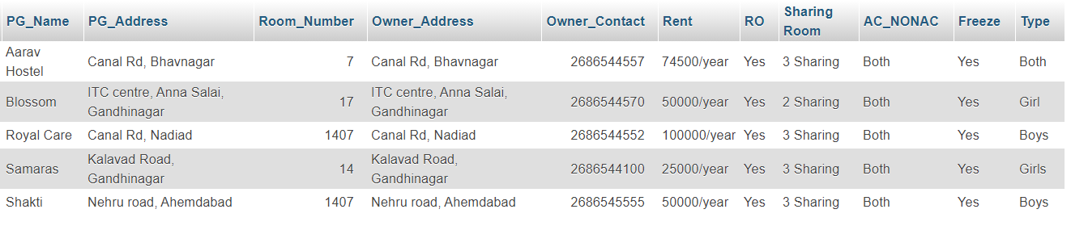
5.2.6 PG_HOSTEL
INSERT INTO `pg_hostel` VALUES ('Royal Care','Canal Rd, Nadiad', 1407, 'Canal Rd, Nadiad', 02686544552, '100000/year' , 'Yes','3 Sharing','Both','Yes','Boys');
INSERT INTO `pg_hostel` VALUES ('Aarav Hostel','Canal Rd, Bhavnagar', 7, 'Canal Rd, Bhavnagar', 02686544557, '74500/year' , 'Yes','3 Sharing','Both','Yes','Both');
INSERT INTO `pg_hostel` VALUES ('Blossom','ITC centre, Anna Salai, Gandhinagar', 17, 'ITC centre, Anna Salai, Gandhinagar', 02686544570, '50000/year' , 'Yes','2 Sharing','Both','Yes','Girl');
INSERT INTO `pg_hostel` VALUES ('Samaras','Kalavad Road, Gandhinagar', 14, 'Kalavad Road, Gandhinagar', 02686544100, '25000/year' , 'Yes','3 Sharing','Both','Yes','Girls');
INSERT INTO `pg_hostel` VALUES ('Shakti','Nehru road, Ahemdabad', 1407, 'Nehru road, Ahemdabad', 02686545555, '50000/year' , 'Yes','3 Sharing','Both','Yes','Boys');

Slide 24
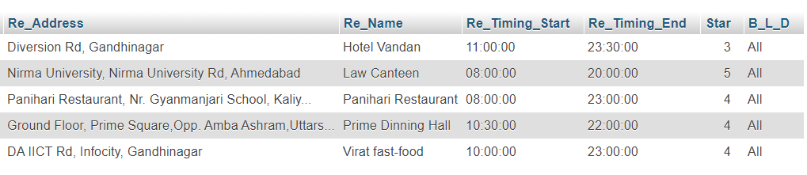
5.2.7 RESTURANT
INSERT INTO `resturant`(`Re_Address`, `Re_Name`, `Re_Timing_Start`, `Re_Timing_End`, `Star`, `B_L_D`) VALUES ('Ground Floor, Prime Square,Opp. Amba Ashram,Uttarsanda Road, near DDIT College, Nadiad','Prime Dinning Hall','10:30:00','22:00:00', 4, 'All');
INSERT INTO `resturant`(`Re_Address`, `Re_Name`, `Re_Timing_Start`, `Re_Timing_End`, `Star`, `B_L_D`) VALUES ('DA IICT Rd, Infocity, Gandhinagar','Virat fast-food','10:00:00','23:00:00', 4 , 'All');
INSERT INTO `resturant`(`Re_Address`, `Re_Name`, `Re_Timing_Start`, `Re_Timing_End`, `Star`, `B_L_D`) VALUES ('Diversion Rd, Gandhinagar','Hotel Vandan','11:00:00','23:30:00', 3, 'All');
INSERT INTO `resturant`(`Re_Address`, `Re_Name`, `Re_Timing_Start`, `Re_Timing_End`, `Star`, `B_L_D`) VALUES ('Nirma University, Nirma University Rd, Ahmedabad','Law Canteen','08:00:00','20:00:00', 4.5, 'All');
INSERT INTO `resturant`(`Re_Address`, `Re_Name`, `Re_Timing_Start`, `Re_Timing_End`, `Star`, `B_L_D`) VALUES ('Panihari Restaurant, Nr. Gyanmanjari School, Kaliyabid, Bhavnagar','Panihari Restaurant','08:00:00','23:00:00', 4, 'All');

Slide 25
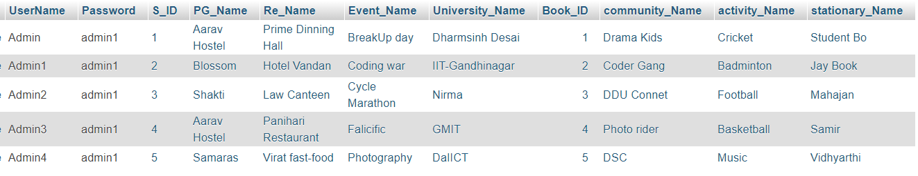
5.2.8 ADMIN
INSERT INTO `admin`(`UserName`, `Password`, `S_ID`, `PG_Name`, `Re_Name`, `Event_Name`, `University_Name`, `Book_ID`, `community_Name`, `activity_Name`, `stationary_Name`) VALUES ('Admin', 'admin1','1','Aarav Hostel','Prime Dinning Hall','BreakUp day','Dharmsinh Desai','1','Drama Kids','Cricket','Student Bo');
INSERT INTO `admin`(`UserName`, `Password`, `S_ID`, `PG_Name`, `Re_Name`, `Event_Name`, `University_Name`, `Book_ID`, `community_Name`, `activity_Name`, `stationary_Name`) VALUES ('Admin1', 'admin1','2','Blossom','Hotel Vandan','Coding war','IIT-Gandhinagar','2','Coder Gang','Badminton','Jay Book');
INSERT INTO `admin`(`UserName`, `Password`, `S_ID`, `PG_Name`, `Re_Name`, `Event_Name`, `University_Name`, `Book_ID`, `community_Name`, `activity_Name`, `stationary_Name`) VALUES ('Admin2', 'admin1','3','Shakti','Law Canteen','Cycle Marathon','Nirma','3','DDU Connet','Football','Mahajan');
INSERT INTO `admin`(`UserName`, `Password`, `S_ID`, `PG_Name`, `Re_Name`, `Event_Name`, `University_Name`, `Book_ID`, `community_Name`, `activity_Name`, `stationary_Name`) VALUES ('Admin3', 'admin1','4','Aarav Hostel','Panihari Restaurant','Falicific','GMIT','4','Photo rider','Basketball','Samir');
INSERT INTO `admin`(`UserName`, `Password`, `S_ID`, `PG_Name`, `Re_Name`, `Event_Name`, `University_Name`, `Book_ID`, `community_Name`, `activity_Name`, `stationary_Name`) VALUES ('Admin4', 'admin1','5','Samaras','Virat fast-food','Photography','DaIICT','5','DSC','Music','Vidhyarthi');

Slide 26
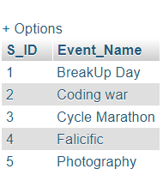
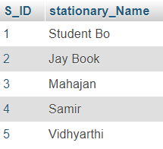
5.2.9 ORGANIZE
INSERT INTO `member`(`S_ID`, `Event_Name`) VALUES ('1','BreakUp Day');
INSERT INTO `member`(`S_ID`, `Event_Name`) VALUES ('2','Coding war');
INSERT INTO `member`(`S_ID`, `Event_Name`) VALUES ('3','Cycle Marathon');
INSERT INTO `member`(`S_ID`, `Event_Name`) VALUES ('4','Falicicfic');
INSERT INTO `member`(`S_ID`, `Event_Name`) VALUES ('5','Photography');
5.2.10 STATIONARY_BUY
INSERT INTO `stationary_buy`(`S_ID`, `stationary_Name`) VALUES (‘1’,’Student Bo’);
INSERT INTO `stationary_buy`(`S_ID`, `stationary_Name`) VALUES (‘2’, ‘Jay Book’);
INSERT INTO `stationary_buy`(`S_ID`, `stationary_Name`) VALUES (‘3’,’Mahajan’);
INSERT INTO `stationary_buy`(`S_ID`, `stationary_Name`) VALUES (‘4’,’Samir’);
INSERT INTO `stationary_buy`(`S_ID`, `stationary_Name`) VALUES (‘5’,’Vidhyarthi’);

Slide 27
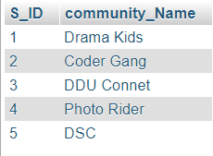
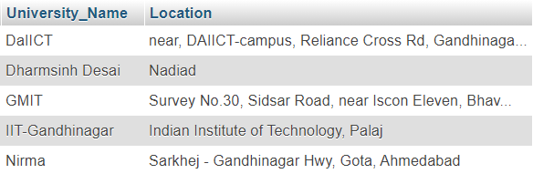
5.2.11 MEMBER
INSERT INTO `member`(`S_ID`, `community_Name`) VALUES ('1','Drama Kids');
INSERT INTO `member`(`S_ID`, `community_Name`) VALUES ('2','Coder Gang');
INSERT INTO `member`(`S_ID`, `community_Name`) VALUES ('3','DDU Connet');
INSERT INTO `member`(`S_ID`, `community_Name`) VALUES ('4','Photo Rider');
INSERT INTO `member`(`S_ID`, `community_Name`) VALUES ('5','DSC');
5.2.12 UNIVERSITY
INSERT INTO `university`(`University_Name`, `Location`) VALUES ('Dharmsinh Desai', 'Nadiad');
INSERT INTO `university`(`University_Name`, `Location`) VALUES ('GMIT', 'Survey No.30, Sidsar Road, near Iscon Eleven, Bhavnagar');
INSERT INTO `university`(`University_Name`, `Location`) VALUES ('DaIICT', 'near, DAIICT-campus, Reliance Cross Rd, Gandhinagar');
INSERT INTO `university`(`University_Name`, `Location`) VALUES ('Nirma', 'Sarkhej - Gandhinagar Hwy, Gota, Ahmedabad');
INSERT INTO `university`(`University_Name`, `Location`) VALUES ('IIT-Gandhinagar', ' Indian Institute of Technology, Palaj');

Slide 28
5.2.13 COURSES
INSERT INTO `courses`(`University_Name`, `Courses_Name`) VALUES ('DaIICT','ICT');
INSERT INTO `courses`(`University_Name`, `Courses_Name`) VALUES ('DaIICT','ICT-CS');
INSERT INTO `courses`(`University_Name`, `Courses_Name`) VALUES ('DaIICT','MnC');
INSERT INTO `courses`(`University_Name`, `Courses_Name`) VALUES ('Dharmsinh Desai','CH');
INSERT INTO `courses`(`University_Name`, `Courses_Name`) VALUES ('Dharmsinh Desai','CE');
INSERT INTO `courses`(`University_Name`, `Courses_Name`) VALUES ('Dharmsinh Desai','IT');
INSERT INTO `courses`(`University_Name`, `Courses_Name`) VALUES ('Dharmsinh Desai','MH');
INSERT INTO `courses`(`University_Name`, `Courses_Name`) VALUES ('Dharmsinh Desai','EC');
INSERT INTO `courses`(`University_Name`, `Courses_Name`) VALUES ('Dharmsinh Desai','IC');
INSERT INTO `courses`(`University_Name`, `Courses_Name`) VALUES ('Dharmsinh Desai','Civil');
INSERT INTO `courses`(`University_Name`, `Courses_Name`) VALUES ('Dharmsinh Desai','BCA');
INSERT INTO `courses`(`University_Name`, `Courses_Name`) VALUES ('Dharmsinh Desai','MBA');
INSERT INTO `courses`(`University_Name`, `Courses_Name`) VALUES ('Dharmsinh Desai','MCA');
INSERT INTO `courses`(`University_Name`, `Courses_Name`) VALUES ('Dharmsinh Desai','BDS');
INSERT INTO `courses`(`University_Name`, `Courses_Name`) VALUES ('Dharmsinh Desai','MBBS');
INSERT INTO `courses`(`University_Name`, `Courses_Name`) VALUES ('Nirma','CS');
INSERT INTO `courses`(`University_Name`, `Courses_Name`) VALUES ('Nirma','EC');
INSERT INTO `courses`(`University_Name`, `Courses_Name`) VALUES ('Nirma','CH');
INSERT INTO `courses`(`University_Name`, `Courses_Name`) VALUES ('GMIT','CE');

Slide 29
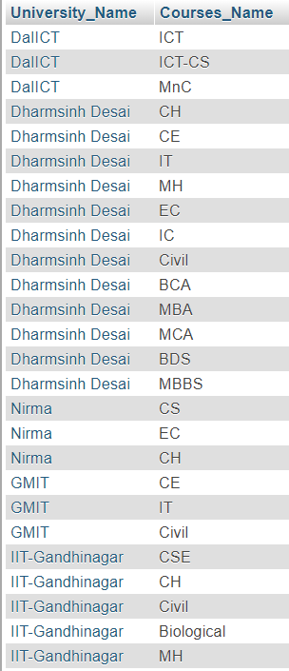
INSERT INTO `courses`(`University_Name`, `Courses_Name`) VALUES ('GMIT','IT');
INSERT INTO `courses`(`University_Name`, `Courses_Name`) VALUES ('GMIT','Civil');
INSERT INTO `courses`(`University_Name`, `Courses_Name`) VALUES ('IIT-Gandhinagar','CSE');
INSERT INTO `courses`(`University_Name`, `Courses_Name`) VALUES ('IIT-Gandhinagar','CH');
INSERT INTO `courses`(`University_Name`, `Courses_Name`) VALUES ('IIT-Gandhinagar','Civil');
INSERT INTO `courses`(`University_Name`, `Courses_Name`) VALUES ('IIT-Gandhinagar','Biological Engg.');
INSERT INTO `courses`(`University_Name`, `Courses_Name`) VALUES ('IIT-Gandhinagar','MH');

Slide 30
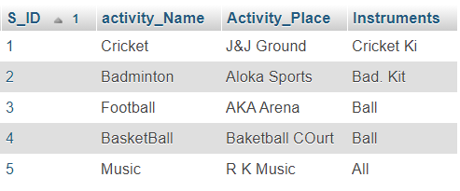
5.2.14 ACTIVITY
INSERT INTO `activity`(`S_ID`, `activity_Name`, `Activity_Place`, `Instruments`) VALUES ('1','Cricket','J&J Ground','');
INSERT INTO `activity`(`S_ID`, `activity_Name`, `Activity_Place`, `Instruments`) VALUES ('2','Badminton','Aloka Sports','Sitar');
INSERT INTO `activity`(`S_ID`, `activity_Name`, `Activity_Place`, `Instruments`) VALUES ('3','Football','AKA Arena','Guitar');
INSERT INTO `activity`(`S_ID`, `activity_Name`, `Activity_Place`, `Instruments`) VALUES ('4','BasketBall','Baketball COurt','');
INSERT INTO `activity`(`S_ID`, `activity_Name`, `Activity_Place`, `Instruments`) VALUES ('5','Music','RK Music','All');

